Slide 1

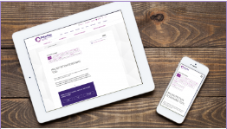



How to use the culturally adapted online MST

Slide 2
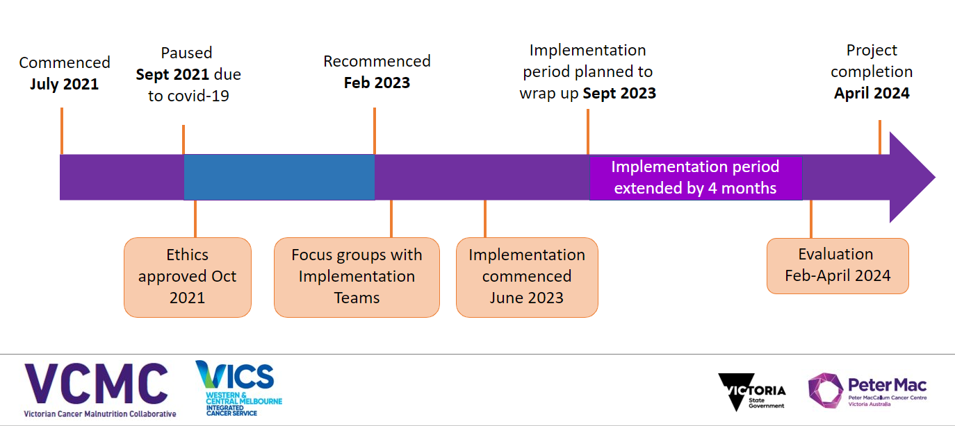
IMPLEMENTATION OF THE CULTURALLY ADAPTED ONLINE INTERACTIVE MST INTO USUAL CARE

Slide 3

WHY WOULD YOU USE THE TOOL?
According to a 2017 survey of Dietitians from 17 Victorian cancer services:
  Only an estimated 1/3 of CALD patients routinely get screened for malnutrition
  Interpreters are used for <1/4 of patients screened for malnutrition, with family members assisting for the majority (85%) of screening of CALD patients
There is a substantial potential for poorer health outcomes in the 2/3 of the CALD cancer population who do not receive routine malnutrition screening
This situation could be prevented with use of an appropriately translated and culturally adapted screening tool

Slide 4

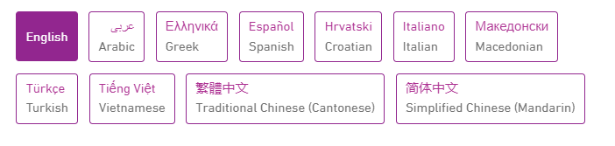
WHEN WOULD YOU USE THE TOOL?
As a part of routine malnutrition screening of patients with cancer
The tool has been translated and culturally adapted into the 10 most commonly spoken languages in Victoria other than English
The tool is available in any of the below languages

Slide 5
BEFORE YOU START...
Use a face-to-face or phone interpreter to introduce the tool if possible
Even though the MST itself is translated and culturally adapted, it is recommended that an interpreter still be used to introduce the tool and relay any queries or questions they might have about it.

Slide 6
BEFORE YOU START...
What is the surrounding environment like – is it noisy?
If you are completing the tool with the patient in a busy or noisy environment (such as a Chemotherapy Day Unit, a waiting room, or a shared room on the ward), it may be hard for the patient to hear and understand the audio
If so, it is recommended that a patient uses headphones with the device or is taken to a quieter place if this is possible and appropriate.

Slide 7
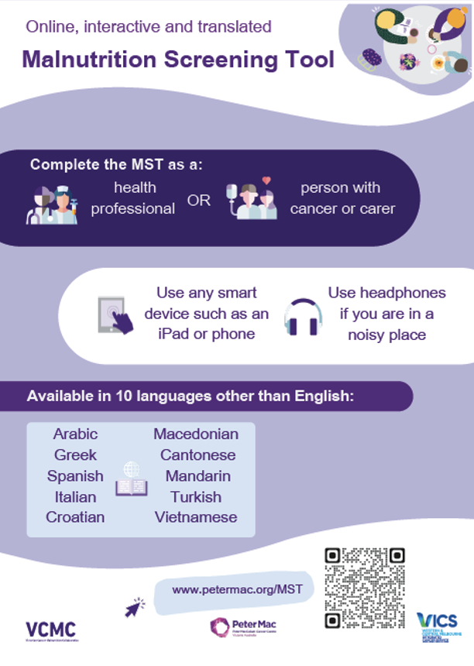
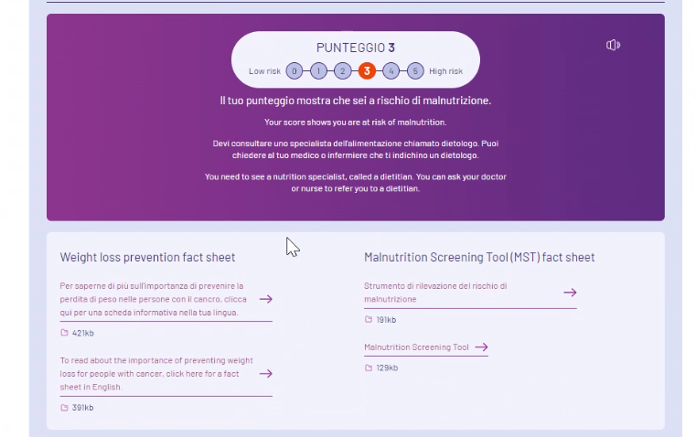
ACCESSING THE TOOL
Your site will have recommended devices for accessing the tool, such as:
  Patients own device using the QR code (look for the infographic on the right around your area)
  ASCOM
  Tablet
  Link through EMR for use on computer
  Bedside terminal
The tool can also be reached at petermac.org/MST
If you are unable to access the online interactive version for any reason, you can go to the hard copy of the translated MST at the link on the bottom of the interactive tool. It is recommended you print this for your patient

Slide 8
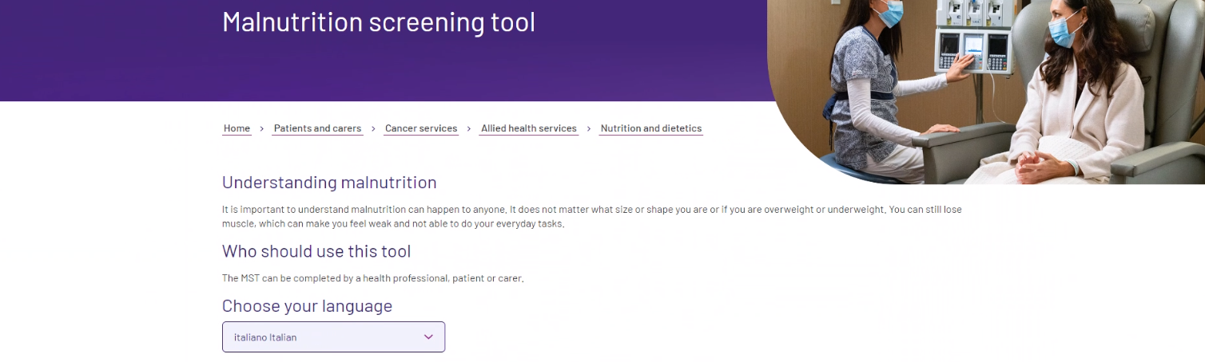
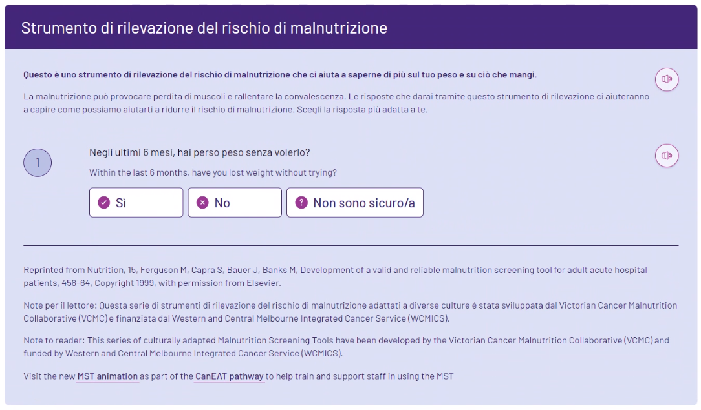
COMPLETING THE TOOL
Select the preferred language of your patient
Select the speaker button on the top right for the text to be read out loud to the patient.

Slide 9
COMPLETING THE TOOL
The remainder of the steps include the question in both the patient’s preferred language and English.
The audio button will allow audio of both the question and the answers.
1. The first question asks if patient has unintentionally lost any weight in the past 6 months – click ‘yes’, ‘no’, or ‘I don’t know’ depending on the patients answer

Slide 10
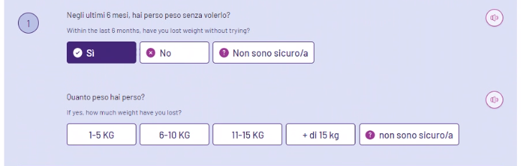
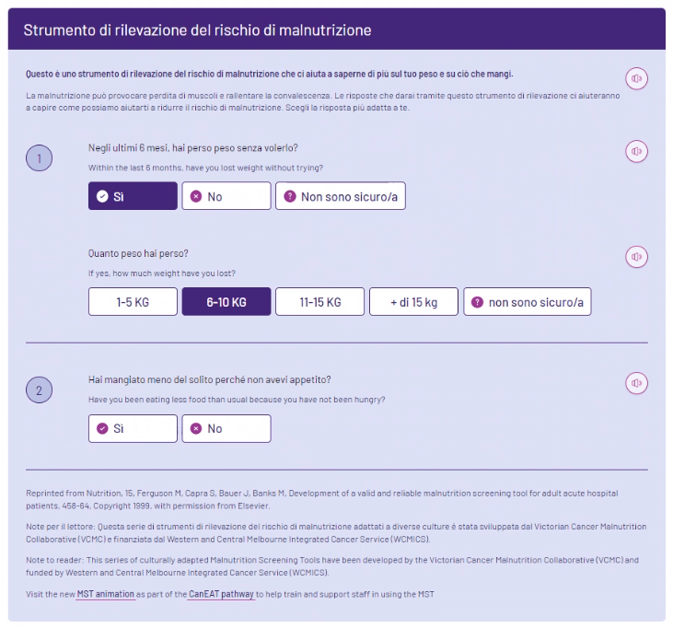
COMPLETING THE TOOL
2. If the patient selects yes to losing weight, a follow-up question will appear asking how much weight the patient has lost. The audio will read out all options for patient to answer.

Slide 11
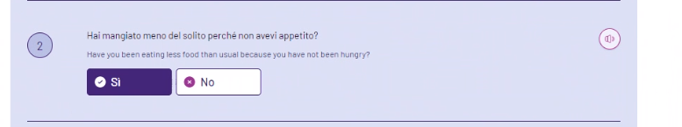
COMPLETING THE TOOL
3. The final question asks about the patient’s appetite and the impact of this on their eating, and requires a yes/no response.
Completing this question will result in an MST score…

Slide 12
COMPLETING THE TOOL
4. The result will then interpret the score (e.g. ‘your score shows you are at risk of malnutrition’) and suggests the most appropriate next step for the patient.
For example, this result indicates an MST=3 – risk of malnutrition, and recommends a referral to a dietitian.

Slide 13

YOU HAVE A RESULT – WHAT’S NEXT?
Was the MST actually completed via the link in the electronic medical record?
If the MST was completed on paper, or the website via an iPad link, ASCOM or on the patients own device, you must manually enter this score into the patient’s medical record and complete the recommended course of action as per your organisational policies and guidelines

Slide 14
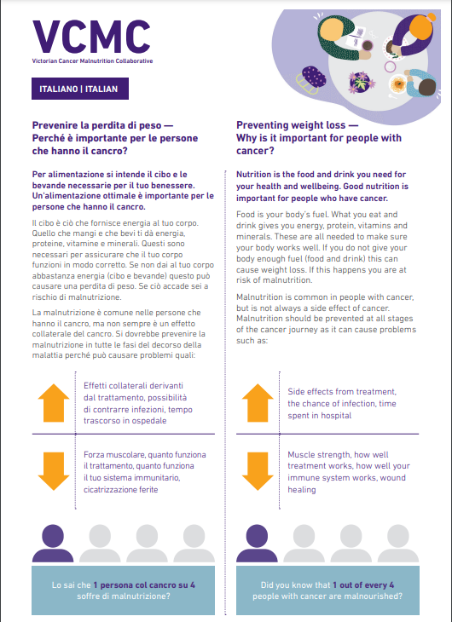
YOU HAVE A RESULT – WHAT’S NEXT?
On completing the online tool, a link will be available to the translated patient information sheet ‘preventing weight loss for people with cancer’.
This fact sheet provides information about the importance of nutrition and preventing weight loss in people with cancer.

Slide 15

OTHER HELP AVAILABLE
Ask your manager to point you towards one of the clinical champions for the online MST at your site
If you need a refresher on completing the MST in English or any other language, you can watch the video here

